Slide 1
PROTOTYPE MODEL

Slide 2
Introduction
Prototyping Model is a software development model in which prototype is built, tested, and reworked until an acceptable prototype is achieved.
It works best in scenarios where the project's requirements are not known in detail

Slide 3
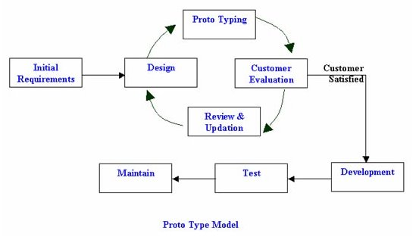

Slide 4
Advantages
This model is flexible in design.
It is easy to detect errors. We can find missing functionality easily. There is scope of refinement, it means new requirements can be easily accommodated.
It can be reused by the developer for more complicated projects in the future.
It ensures a greater level of customer satisfaction and comfort. It is ideal for online system.

Slide 5
Problem statement
The Baby Toy Company was selling premium toys but the business had been stagnant over the years.
A survey was conducted on kids and their preference for toys and it was found that attention span/engagement with a new toy lasts only few days for kids and they start demanding a new one within a week.
However, the survey also brought out that parents found affording premium toys difficult.
So company has decided to rent the premium toys.

Slide 6
Why?
As It is new idea, any number of changes can be made as per customer feedback as it is flexible in nature.
The company is not sure about requirements and number of functionalities needed
As the company process is online, this prototype is ideal for online system.
Hence the prototype model is best suitable for the company.

Slide 7
Requirements
Functional requirements:
Login/create account
Number of days and price information
Shipment
Payment gateway

Slide 8
Non functional requirements:
number of people login and use the application at same time
User interface
Categories of the product

Slide 9
Disadvantages
This model is costly.
It has poor documentation because of continuously changing customer requirements.
There may be too much variation in requirements. Customers sometimes demand the actual product to be delivered soon after seeing an early prototype.
There may be sub-optimal solutions because of developers in a hurry to build prototypes. Customers may not be satisfied or interested in the product after seeing the initial prototype.

